Slide 1
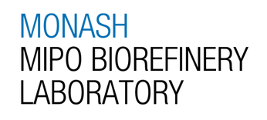
Valorization of Pyrolysis Oil towards Marine Fuel and Asphalt Utilization
Kong Yue Xuan
21/05/2026 9am
GRS Meeting and Presentation
1

Slide 2
Introduction
Decarbonization
Alternative energy sources (wind, solar, hydro)
  Generally suitable for electrifying
  Lack of energy density despite advances in battery technology (around 1 MJ/kg)
Marine Fuel Oil
  Requires energy dense fuel (40 MJ/kg)
  Produced from fossil fuel distillate residue
Alternative carbon source
  Converts hard to store “electrifying” energy into storable “fuel”
2

Slide 3
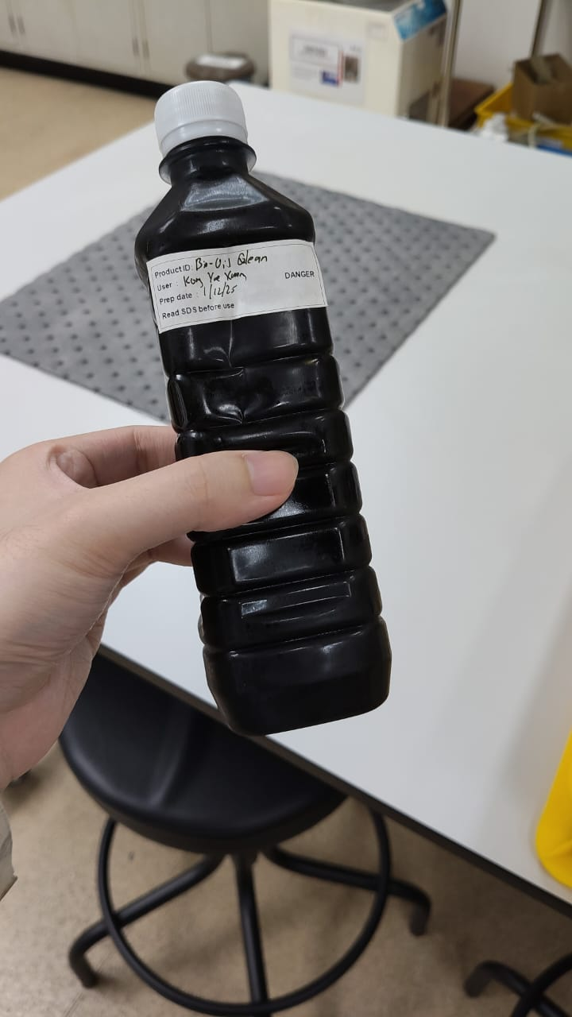
Introduction
Pyrolysis Oil (Py-Oil) from Palm Biomass
Abundant quantities of palm biomass in Malaysia
A significant byproduct in production of biochar
A concentrated source of carbon
3

Slide 4
Biomass Py-Oil: Bottlenecks to Adoption
Property | Problem
Highly polar, high water content | Poorly miscible with nonpolar fuels
Highly acidic (TAN* > 70) | Corrosive to engines
Presence of active functional groups | Unstable with poor shelf life
Presence of oxygenated compounds | Low calorific value
Presence of tar, wax and highly polymerized components | Poor engine performance, inconsistent viscosity
Presence of Polycyclic Aromatic Compounds (PACs) | Carcinogenic
*Total Acid Number (TAN) is a measure of fuel acidity, in mg KOH to neutralize 1 g of fuel.
4

Slide 5
Biomass Py-Oil: Upgrading
Method | Effect on Fuel | Bottleneck
Hydrodeoxygenation and catalytic cracking [1][2][3] | Removes oxygen, reduces acidity and increases stability and energy density | Severe coke formation, harsh conditions, hydrogen requirement
Esterification [4][5][6] | Reduces acidity, increases energy density and increases stability | Heavy wastewater generation, catalyst deactivation, recovery and regeneration, water inhibition
Blending with emulsions and surfactants [7][8] | Reduction of impurities via dilution | Fuel downgrading and stability
Acid-Base Wash [9][10] | Removes trace impurities and tar, removes acidity | Water and chemical waste generation
5

Slide 6
The Gap
No published literature discusses the direct fractionation of pyrolysis oil, coupled with blending with marine fuel oil.
6

Slide 7
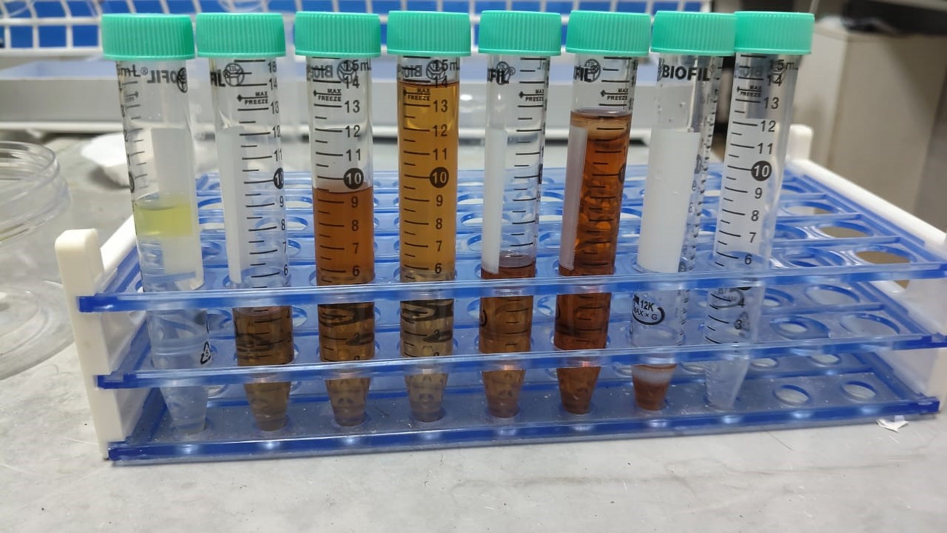
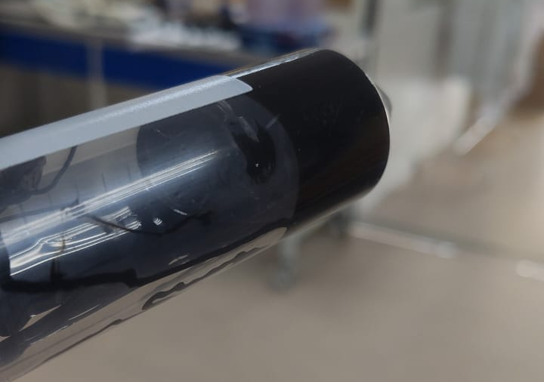
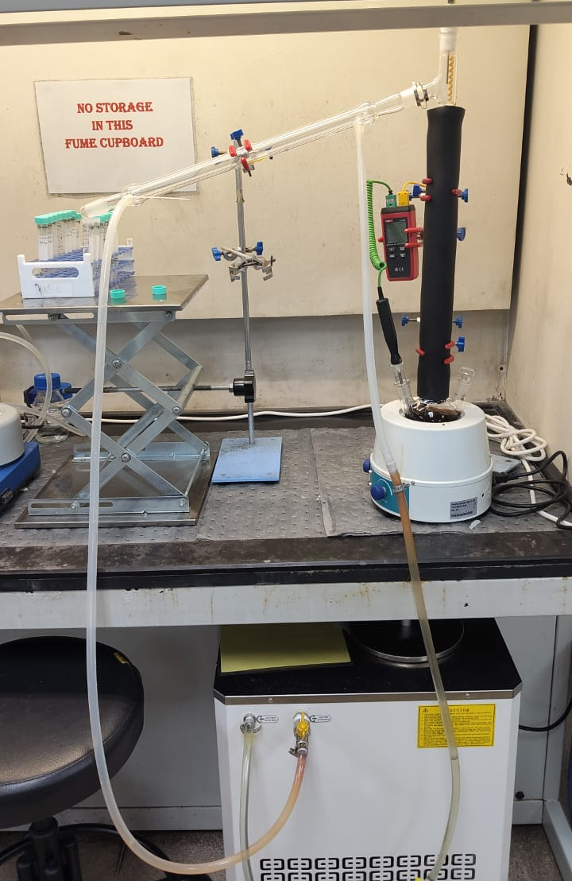
Setup and process
Condenser
Vapor temperature measurement
Fraction 4
Sampling point
Vigreux column with heat insulation
Fraction 1
Fraction 3
Fraction 2
Fractionation of bio-oil
Heating mantle
Temperature profile for different distillation fractions of bio-oil
No. | Fraction | Vapor temperature (°C) | Volume (%)
1 | Water phase | ≤ 100 | 7.0
2 | Light distillate | 100 – 180 | 11.18
3 | Heavy distillate | 180 – 190 | 27.20
4 | Bottom phase | > 190 | 54.62
38.38% of distillate can be recovered
Potential improvement with vacuum distillation setup
Chiller circulator
7

Slide 8
  DISTILLATE CHARACTERISTICS AND STABILITY
Parameter | Limit | RMG | RMK | B24 | MFO | Bio-Oil | Light Distillate | Heavy Distillation | Light Distillate (D-7) | Heavy Distillate (D-7)
Viscosity at 50 °C (cst) | Max | 180-700 | 380-700 | 380 | 212 | 17 | 2.3 | 3.7 | 2.9 | 4.0
Density at 15 °C (kg/m³) | Max | 991 | 1010 | 991 | 991* | 1083 | 1044 | 1043 | 1045 | 1057
Aluminum + silicon (mg/kg) | Max | 60 | 60 | 60 | 24 | 1.03 | 0.62 | 0.48 | 0.62 | 0.48
Sodium (mg/kg) | Max | 100 | 100 | 100 | 27 | 0 | 0 | 0 | 0 | 0
Vanadium (mg/kg) | Max | 350 | 450 | 350 | 0 | 0 | 0 | 0 | 0 | 0
CCAI | Max | 870 | 870 | 870 | 858 | 988 | 1005 | 987 | 998 | 999
Water (% V/V) | Max | 0.5 | 0.5 | 0.5 | 0.36 | 7.79 | 11.02 | 6.07 | 10.91 | 6.61
Sulphur (% m/m) | Max | n/a | n/a | 0.5 | 0.35 | 0.21 | 0.02 | 0.01 | 0.02 | 0.01
Acid number (mg KOH/g) | Max | 2.5 | 2.5 | 2.5 | 1.13 | 74.6 | 247.7 | 20.2 | 220.5 | 19.8
Calcium (mg/kg) | Max | 30 | 30 | 30 | 45* | 0.3 | 0.3 | 0.2 | 0.3 | 0.2
Zinc (mg/kg) | Max | 15 | 15 | 15 | 0 | 0 | 0 | 0 | 0 | 0
Phosphorus (mg/kg) | Max | 15 | 15 | 15 | 9.67 | 2.38 | 0.02 | 0.03 | 0.02 | 0.04
Potassium (mg/kg) | Max | n/a | n/a | 50 | 35 | 0 | 0 | 0 | 0 | 0
Nitrogen content (% m/m) | Max | n/a | n/a | 0.35 | 0.15 | 0.02 | 0.09 | 0.16 | 0.09 | 0.16
Gross calorific value (MJ/kg) | Min | n/a | n/a | 39.5 | 42.4 | 28.1 | 25.3 | 30.2 | 25.2 | 30.0
Iodine value (g I²/100 g) | Max | n/a | n/a | 300 | 8.5 | 47.0 | 48.4 | 47.8 | 32.3 | 35.8
Chlorine content (mg/kg) | Max | n/a | n/a | n/a | 1215 | 1835 | 95 | 29 | 95 | 29
*Remark: density assumed to be 991 kg/m3 due to limitation of equipment
*Remark: Only fails when Ca >30 and Zn or P>15, considered as the presence of used lubricating oil (ULO)
Bio-oil and distillate fractions have slightly higher density than specifications
Very poor performance in water content and acid value
Aging does not change properties significantly
8

Slide 9




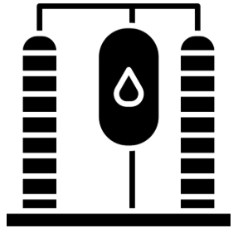

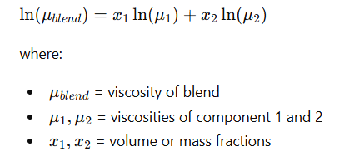




  BLENDING RATIO DETERMINATION
1. Blending Scenarios
2. Calculation Approach
Distillate Fractions Analyzed:
Fuel properties estimated via linear or near-linear relationships.
•
Light distillate
Viscosity evaluated using non-linear models due to non-ideal fluid behavior.
•
Heavy distillate
•
Whole distillate (combined fractions)
3. Limiting Properties
4. Final Blending Ratios
Primary constraints identified: Water Content & Acid Number.
Light Distillate | 0.5% | 1%
Heavy Distillate | 4% | 8%
Whole Distillate | 0.5% | 1%
•
Properties exceeded marine fuel limits by approximately one order of magnitude.
•
These parameters strictly governed the maximum allowable blending ratios.
Half of the calculated maximum blending ratio was additionally tested to provide a conservative and safer performance estimation
9

Slide 10
  BLENDED FUEL PROPERTIES
Parameter | Limit | RMG | RMK | B24 | 0.5% Light | 1% Light | 4% Heavy | 8% Heavy | 0.5% Whole | 1% Whole
Viscosity at 50 °C (cst) | Max | 180-700 | 380-700 | 380 | 205 | 197 | 195 | 196 | 202 | 195
Density at 15 °C (kg/m³)* | Max | 991 | 1010 | 991 | 991 | 991 | 993 | 995 | 991 | 992
Aluminum + silicon (mg/kg) | Max | 60 | 60 | 60 | 36 | 28 | 28 | 34 | 31 | 32
Sodium (mg/kg) | Max | 100 | 100 | 100 | 45 | 32 | 36 | 38 | 35 | 35
Vanadium (mg/kg) | Max | 350 | 450 | 350 | 0 | 0 | 0 | 0 | 0 | 0
CCAI | Max | 870 | 870 | 870 | 859 | 860 | 861 | 863 | 859 | 860
Water (% V/V) | Max | 0.5 | 0.5 | 0.5 | 0.47 | 0.43 | 0.48 | 0.53 | 0.49 | 0.43
Sulphur (% m/m) | Max | n/a | n/a | 0.5 | 0.34 | 0.33 | 0.34 | 0.33 | 0.31 | 0.36
Acid number (mg KOH/g) | Max | 2.5 | 2.5 | 2.5 | 2.67 | 3.71 | 2.40 | 3.26 | 2.45 | 4.98
Calcium (mg/kg) | Max | 30 | 30 | 30 | 53* | 47* | 51* | 55 | 52* | 54
Zinc (mg/kg) | Max | 15 | 15 | 15 | 0 | 0 | 0 | 0 | 0 | 0
Phosphorus (mg/kg) | Max | 15 | 15 | 15 | 13 | 13 | 4 | 24 | 5 | 29
Potassium (mg/kg) | Max | n/a | n/a | 50 | 46 | 39 | 39 | 49 | 45 | 44
Nitrogen content (% m/m) | Max | n/a | n/a | 0.35 | 0.15 | 0.15 | 0.16 | 0.16 | 0.15 | 0.16
Gross calorific value (MJ/kg) | Min | n/a | n/a | 39.5 | 42.5 | 42.1 | 43.1 | 42.0 | 41.4 | 42.9
Iodine value (g I²/100 g) | Max | n/a | n/a | 300 | 17.8 | 14.1 | 16.8 | 20.6 | 18.5 | 15.2
Chlorine content (mg/kg) | Max | n/a | n/a | n/a | 1553 | 1326 | 1574 | 1424 | 1460 | 1679
*Remark: density calculated from linear contribution from both MFO and bio-oil distillates due to limitation of measuring equipment
*Remark: Only fails when Ca >30 and Zn or P>15, considered as the presence of used lubricating oil (ULO)
High acid number of light distillate limits blending
Currently, 4% heavy distillate and 0.5% whole distillate blend fulfils specifications
Proposed way would be direct blending with heavy distillate and trans-esterification/acid-alkaline washing to reduce acid value for light distillate
Notes:
Impurities values for blended samples are higher than pure samples, probably due to improved solubility of these impurities from the bio-oil distillates in the presence of MFO (the distillates themselves cant really dissolve well in our current ICP-OES solvent for analysis)
The heavy distillate fraction was estimated to consist predominantly of compounds within the carbon number range of approximately C10–C15. A distillation cut-off temperature of 180°C was selected as it is commonly regarded as the transition point between gasoline-range and kerosene-range fractions. Distillation was terminated at 190°C due to a significant reduction in distillation rate, which was attributed to coke and solid residue formation in the undistilled bottom phase within the flask. Future improvements may include the implementation of vacuum distillation to reduce thermal degradation and coke formation, or lowering the cut-off temperature to approximately 150°C to obtain a cleaner and more stable distillate fraction.
The higher moisture content and acid number observed in the light distillate (100–180 °C) can be directly related to its GC–MS profile, which shows a greater proportion of oxygenated compounds and fewer hydrocarbons compared to the heavier fraction. Oxygenated species such as organic acids, aldehydes, ketones, and low-molecular-weight phenolics are more polar and hygroscopic, meaning they tend to retain or associate with water more strongly, contributing to the higher measured moisture content. In addition, the enrichment of carboxylic acid–containing compounds in this fraction directly increases the acid number. In contrast, the heavy distillate (180–190 °C), being richer in hydrocarbons and more stable aromatic structures with fewer oxygenated functionalities, is less polar, less hygroscopic, and contains fewer acidic species, leading to lower moisture retention and a reduced acid number.

Slide 11
Future Planned Work
Application of vacuum distillation to improve distillate yield
Application of further pre- and post-treatment
  Esterification
  Base wash decarboxylation
  Acid-base wash
  Bleaching
11

Slide 12
Valorization of Pyrolysis Oil towards Marine Fuel and Asphalt Utilization
Kong Yue Xuan
03/06/2026 9am
PR Meeting and Presentation
12

Slide 13
Current Experimental Rig
Vapor Temp Collection (T2)
Long Liebig Condenser (5C)
Vigruex Column
Collection
Reboiler Pot (T1)
13

Slide 14
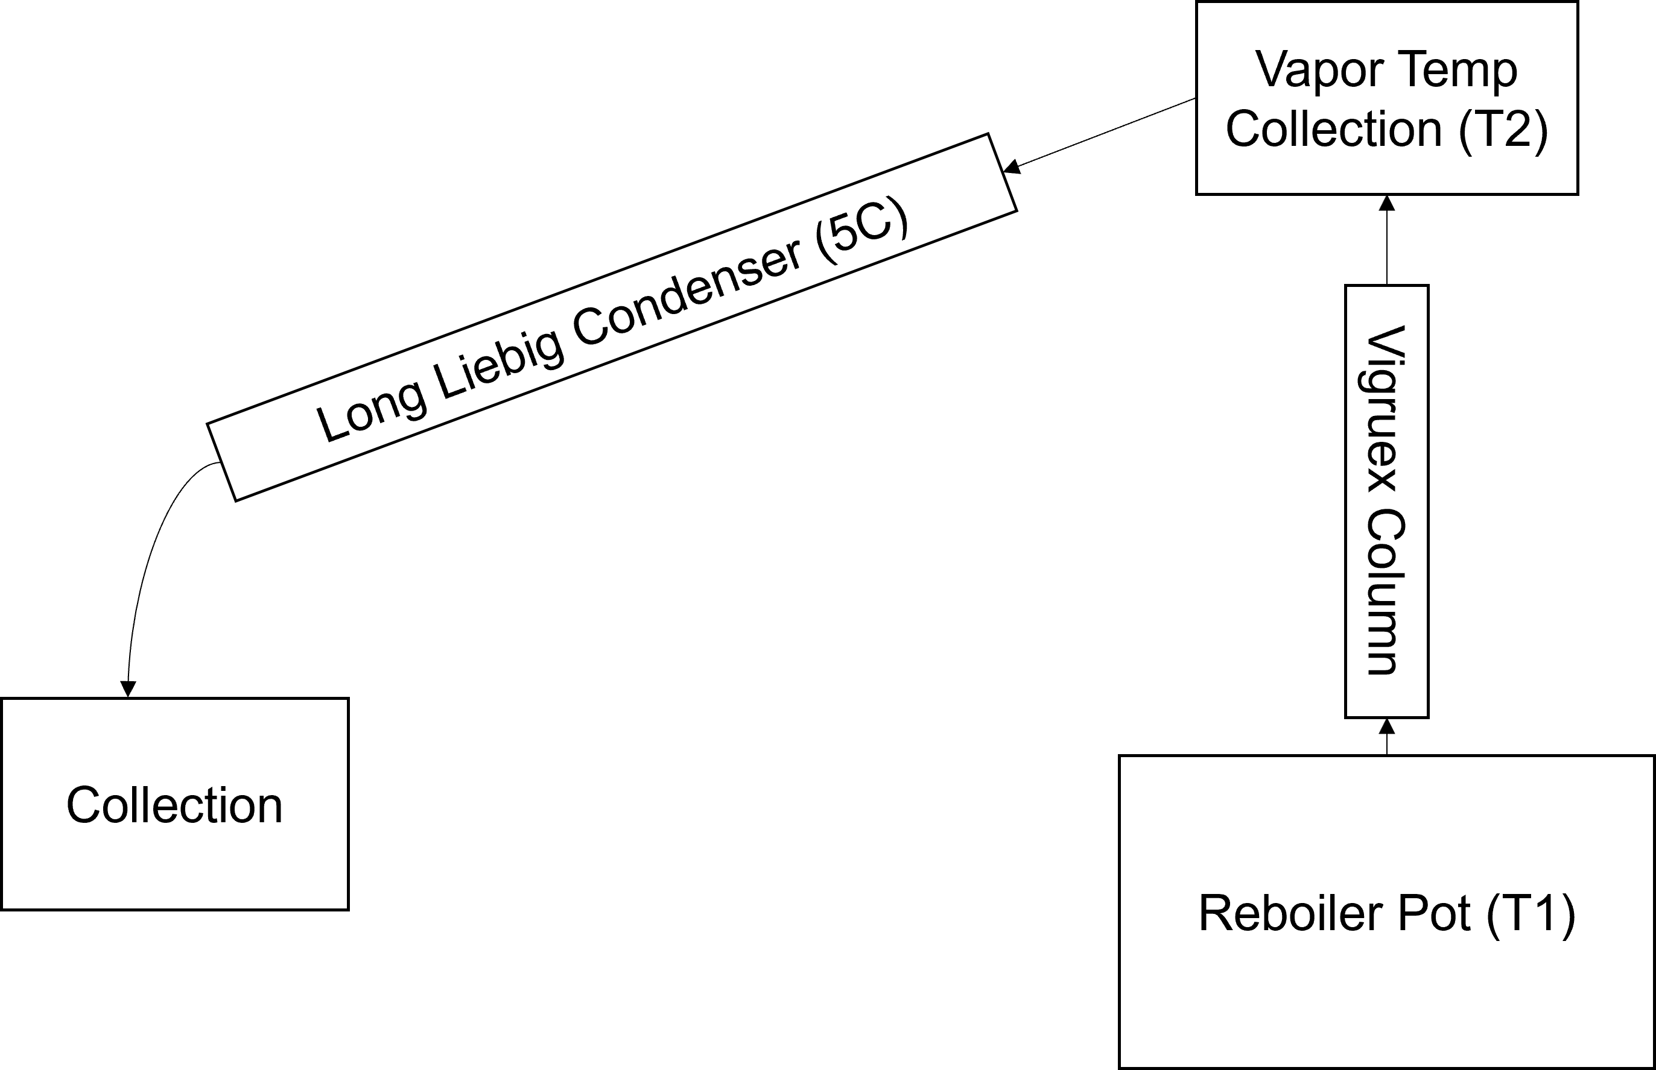
Current Experimental Design
Aim: To investigate the effects of distillation temperature and pressure to product yield and composition.
Varying reboiler temperature (T1) and system Pressure
  150 to 350C
  1atm, 10-30mbar (depending on vac pump)
Measuring the product
Yield, composition (GCMS), corresponding vapor temperature (T2)
Hypothesis: Reboiler temperature is the only significant factor of distillate yield, due to the reactive nature of the process.
14

Slide 15
Current Experimental Progress/Observations
Reboiler Temperature \ Measured Parameters | 150C | 200C | 250C
Lighter than water distillate | Yes | Yes | Yes
Water distillate | Yes | Yes | Yes
Non-water distillate | No | No | Yes
Peak Vapor Temperature | 100 | 100.8 | 186.6
  Note the lack of non-water distillate (>100C distillate) at <200C reboiler temperatures
  Observation when conducting the 250C reboiler temperature run: vapor temperature reached a local peak at 104C(Reboiler temp at 220C), decreased to 101C and then peaked at 186.6C
  Distillation did not stop after vapor temperature peaked, indicative of production of lower BP compounds
15

Slide 16
Regarding the Water phase
Some preliminary GCMS results suggest that the water phase can be directly used as wood vinegar
What is required to be properly sure
  OMRI database search (very time consuming)
Not expected to be in scope of research project
16

Slide 17
The bottom phase
Low temperature distillation (reboiler temp < 200C) runs seems to only result in water removal, producing a heavy and highly acidic bottom phase
Heavy phase properties:
  High viscosity (flowable at room temperature)
  High acidity
  Low water content (around 0.8%)
  Possibility for blending with MFO if the acidity can be managed(?)
17

Slide 18
Valorization of Pyrolysis Oil towards Marine Fuel and Wood Vinegar Utilization
8/9/2026
Kong Yue Xuan, GRS Meeting
18

Slide 19
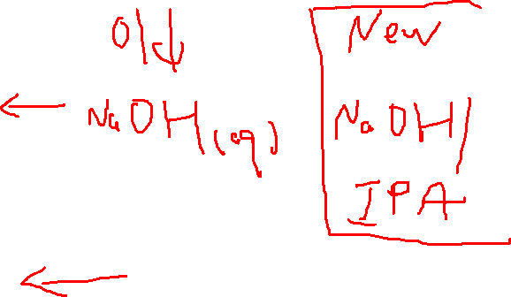
Follow up on water stripping method
Direct single batch water addition
Scanning range between 0 to 100 wt% water addition wrt oil mass
Results here are “earliest analysis possible results”, red results are remeasured due to method changes.
Water (wt% wrt Oil) | Yield (wt/wt oil) | TAN [old method] (mg KOH/g) | TAN [new “better” method] (mg KOH/g)
0 | 0.87 | 68.64 ± 0.04 | 77.65 ± 1.88*
10 | 0.84 | 66 ± 0.58 | 76.47 ± 1.89*
20 | 0.82 | 62.69 ± 1.50 | 75.46 ±1.94*
30 | 0.81 | 59.205 ± 1.80 | 75.03 ± 1.68*
40 | 0.84 | 55 ± 1.00 | 73.79 ± 1.71
50 | 0.81 | 51 ± 1.00 | 67.47 ± 1.36
100 | 0.80 |  | 61.30 ± 0.59
*need to remeasure as the TAN method develops to maturity.
19

Slide 20
Follow up on water stripping method
Direct single batch water addition
Scanning range between 0 to 100 wt% water addition wrt oil mass
Results here are “earliest analysis possible results”, red results are remeasured due to method changes.
*need to remeasure as the TAN method develops to maturity.
20

Slide 21
Follow up on water stripping method
Direct single batch water addition: aging
Sample aged for 3 days and remeasured. Both use the new “better” method
Water (wt% wrt Oil) | Yield (wt/wt oil) | TAN [T+0 days] (mg KOH/g) | TAN [T+3 days] (mg KOH/g)
100 | 0.80 | 61.30 ± 0.59 | 68.22 ± 2.08
21

Slide 22
Other water stripping methods
Everything I can think of that’s not batch water addition
Use peristaltic pump to drip water into dry oil (some yt videos show the schema)
  Requires POC
Use glass delivery tube with rubber stopper to push steam to bubble through oil (requires prototyping)
  Requires glass delivery tube 90 degrees and a second heating mantle
  Downside is the flowrate of steam is not easily known unless you do a super mat balance
The steam coil stripping thing
  Maybe do when the other two fail
  Requires equipment assessment and POC first.
Direct water extraction
  Not novel, but might be necessary as a benchmark
22

Slide 23
The phenyl ester pathway: a POC
Seems to work(?)
Reaction conditions: Azeotropic Dean stark setup: 48h, 1:1 oil/cyclohexane, 1% sulphuric acid and 1% boric acid. Pot temp is slightly higher than reflux temperature (85C) to maintain overall temperature.
Result: a TAN of 47, correcting for the two-acid catalyst is 35.
Water content is stable at around 0.3%.
23

Slide 24
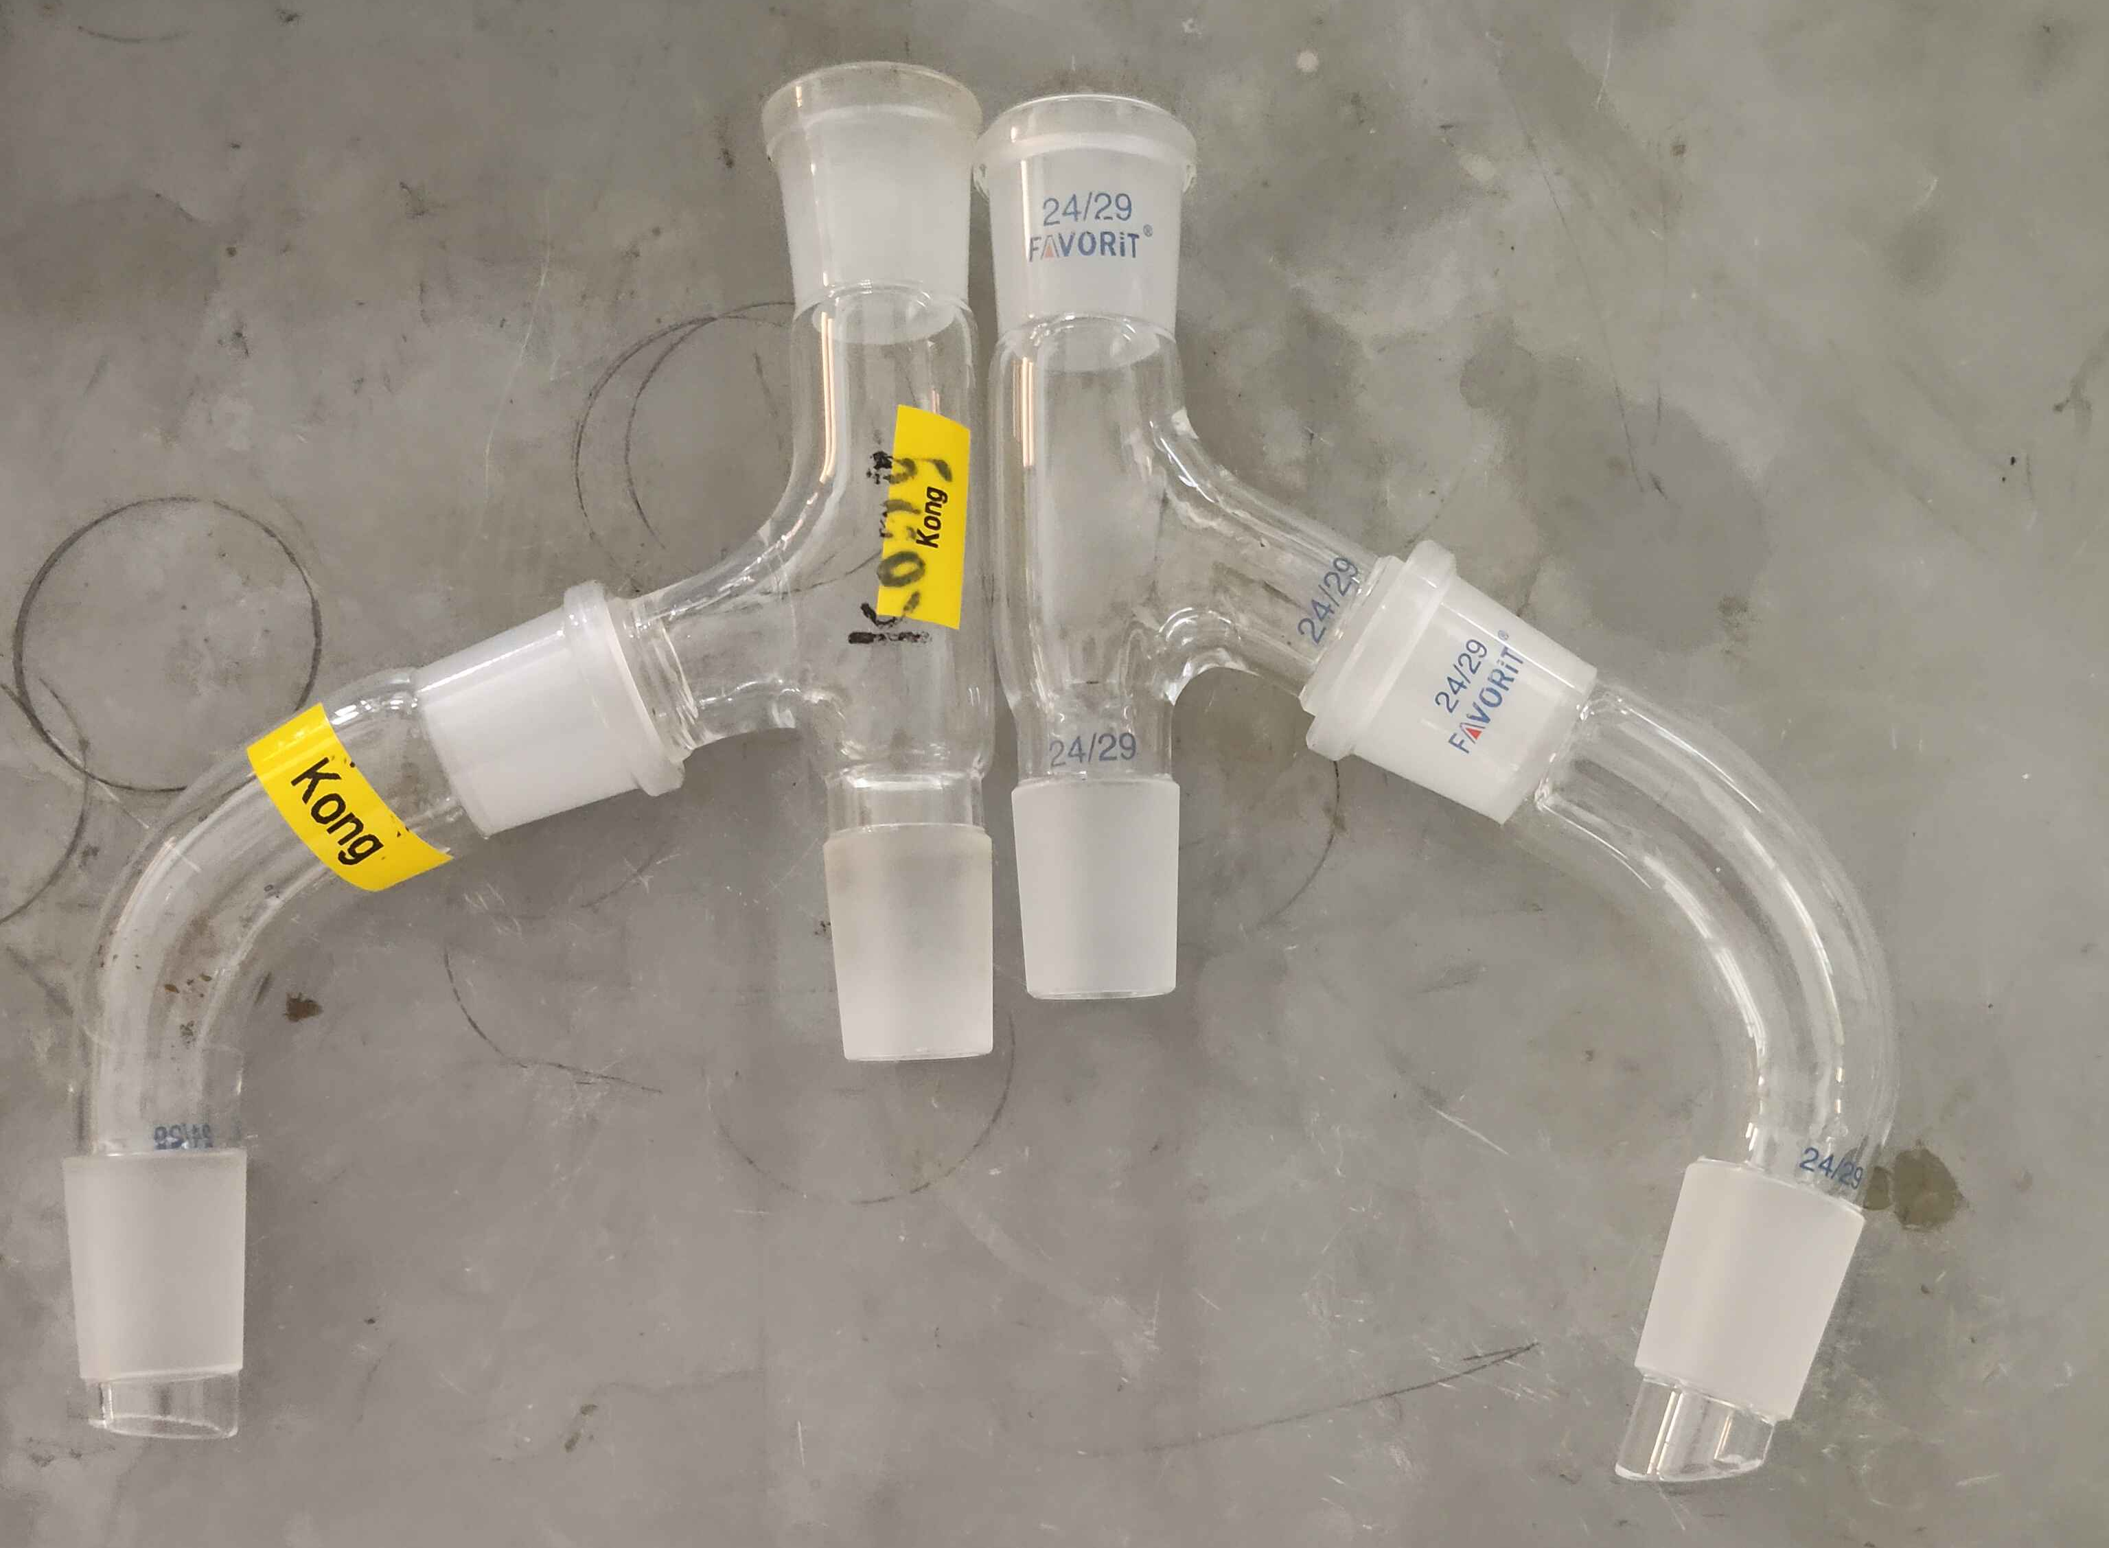
Some current problems
Glassware: the three neck and bent neck I only have one set that connects perpendicularly (see picture)
GC-MS still not working, need to find time to see if Agilent’s low capacity method (3 vials at a time) can work.
Still has some issues with the TAN measurement, particularly due to NaOH precipitation over time. Needs some time to iron out the operational details.
24

Slide 25
One more thing
Request leave for 14th October to 26th October.
25

Slide 26
Valorization of pyrolysis oil towards Marine Fuel Oil and Wood Vinegar
Kong Yue Xuan
21 Sep 2026
5537 and 5414
26

Slide 27
Introduction
Decarbonization and Pyrolysis Oil
Marine transportation
  3% of global emissions
  Critical to global economy
Introduction of EU ETS and FuelEU, carbon tax initiatives from the European Union
  A minimum of 6% renewable fuel blend required to achieve emission limits
Pyrolysis Oil
  Waste product from biochar production
  High potential
    Carbon and energy rich
  Underutilized
    Oxygenated groups: polar, polymerization
    Highly acidic, measured as Total Acid Number (TAN)
    High water content

Slide 28
Introduction
Literature
Hydrogenation/Catalytic Cracking[1][2]: Produces high-quality gasoline/kerosene and syngas, but harsh conditions/high cost and catalyst deactivation
Alcoholic Esterification[3][4]: Acetalize and esterify problematic functional groups (carboxylics and carbonyls), generally
Direct distillation[5]: Useful to extract chemical compounds, but produces solid coke
Water extraction[6]: Removes acids, sugars and other highly polar compounds.
Phenyl Esterification[7]: Used to extract phenyl esters from pyrolysis oil.

Slide 29
Problem Statement
Basis and direction
Theoretical basis: Phenols and short chain carboxylics are acidic and form minimum boiling azeotropes with water, therefore can be stripped with water.
  Hypothesis: Suitable addition of water into pyrolysis oil distillation can reduce the acidity of the oil.
Superiority to water extraction: retention of yield and polar compounds; single pot process, produces a wood vinegar-like distillate that may be of moderately high value.
No published studies have attempted water stripping of biomass-based pyrolysis oil.

Slide 30
Aims and Objectives
Basis and direction
To assess the viability of water stripping on reducing acidity of biomass-derived pyrolysis oil.
  To optimize conditions for water stripping such as temperature and water dosing.
  To characterize the resulting pyrolysis oil for various physiochemical properties to determine blending ratios in marine fuel oil.
  To characterize the resulting water distillate for suitability as wood vinegar byproduct.

Slide 31
Experimntal Setup
Lab work
Add 150g of oil + an amount of water into flask.
Heat flask until 150 °C to completely strip off water. This is the optimal temperature to complete proper water removal without significantly increasing viscosity of pyrolysis oil.
Use of fractionation column: Supresses non-aqueous volatiles from escaping, decreasing yield.
Experimental Setup. [8]

Slide 32
Results
Effect of water dosage on acidity
Measured using ASTM 667.
Initial TAN before distillation was measured to be 103 mg KOH/g oil.
Water stripping shows minorly good results with some correlation.
Suspect that the main compound removed (phenolics) does not show up in measurements.

Slide 33
Results
Effect of water dosage on acidity
Inflection point at around 15.4mL NaOH or -70 mV (see red marker).
Phenols deprotonate at a pH of >10 [9].
Calibration against buffers demonstrate that pH10 corresponds to -124.1 mV (see green marker).
No significant inflection point there, evidenced by dU/dV curve.

Slide 34
Results
Effect of water dosage on acidity
Some decrease in phenols content
Pending proper quantification and changes in all functional groups due to problems in the GC-MS.

Slide 35
Future work
Potential avenues
General conclusion: water stripping does not work to reduce measurable acid content using standard measurement techniques (ASTM667)
Wrap up GC-MS results, potentially explore other ways to frame the results to be non-negative.
  A better C-H atomic balance, fuel combustion properties as phenol is notoriously hard to burn
Other potential avenues:
  Alcoholic esterification (explore various alcohols, catalysts, water removal techniques, acetalization techniques)
  Phenyl esterification (explore various catalysts, very new field)

Slide 36
Valorization of pyrolysis oil towards Marine Fuel Oil and Wood Vinegar
Kong Yue Xuan
8 Oct 2026
5537 and 5414
36

Slide 37
The effects of water stripping to acidity
Reconciliating internal measurements with external labs
Water Loading (wt% wrt oil) | TAN (internal) | TAN (SGS) | Yield
30 (28/07/2026) | 59.4772 | 56 | 0.81
50 (13/8/2026) | 64.0967 | >90 | 0.81
100 (21/9/2026) | 70.4767 | 56 | 0.80
200 (25/9/2026) | 59.4235 | 48 | 0.75
Pure MFO sample | 1.82 | 3.3
Samples are measured on 3rd Oct by SGS and 25th Sept internally.
Sample preparation dates are listed.
50% has largest deviation, unclear why sgs managed to measure >90.
The 100 and 200% samples have largest deviation, suspected is due to the difference in measurement times.
SGS measurement of pure MFO is higher than allowable standard (3.3 mg KOH/g oil).
SGS results would suggest that no significant difference in acidity was observed when the samples are aged after a few weeks time.
37

Slide 38
The effects of water stripping to acidity
Reconciliating internal measurements with external labs
Water stripping may be removing substances that will polymerize eventually anyways after heating. Pyoil is unstable at high temperatures and will continue to react even after cooling down.
Expected TAN to go down over time, viscosity go up, due to distillation removing water, favouring polymerization.
Previous results that suggest that TAN goes up due to aging can be explained due to systemic experimental error, notably low titrant/large error at calibrations.
38

Slide 39
The effects of water stripping to acidity
Future plans
If we want to proceed with this, need to shift focus to maybe compounds extraction via water stripping?
  Basically a GC-MS paper.
If want to proceed with this, timed and scheduled experiments will be required.
  Basically full aging study, then focus on what GC-MS says we extracted from the oil.
  Main competition is with water extraction, can say that this produces a cleaner product than direct LLE with water.
To write a paper on this:
  TAN, water content, GC-MS (main deal), aging of BOTH distillate and bottom phase.
  Main bottleneck currently: the GC-MS is refusing to detect acetic acid. Other papers use the same column and same agilent GC-MS and can detect.
39

Slide 40
The storyline
How to continue the Phase 1 study
We don’t say that water stripping fail, we say that it didn’t address the acidity problem but we extract value-added compounds from the oil?
Follow up by saying that we think another way (water extraction, vacuum dry and age) might still work out, given that we can still get value added distillate. Still focus on GC-MS as the primary tool to see what we can pull out.
So the story goes like this: before we use whatever bottoms we have left as MFO, we try to extract useful stuff from it first.
40

Slide 41
The effects of water stripping to acidity
Miscellaneous Content
Investigating other pathways to reduce the TAN:
  Alcoholic Esterification: FYP, attempt uses of other entrainers (one potential is diethylether, although there’s some safety concerns)
  Phenyl Esterification
  Water Extraction, neutralization: not research-grade worthy unless maybe we investigate aging after a series of extractions?
Analysis methodologies
  GC-MS: can load 3 vials at a time, cannot detect acetic acid, try new more polar column (DB-WAX instead of HP-5)
  KF: Our current method seems to overestimate the water content of pyoil by 4x compared to SGS.
Miscibility and homogeneity: Blending pyoil with MFO has miscibility problems, evidenced by blend in tube -> sample -> measure vs blend in beaker -> measure. Latter matches up with TAN modelling
41

Slide 42
42

Slide 43
43

Slide 44
44

